Slide 1
Literary History
5V
November 2023, December 2023, January 2024
Test in Testweek 2

Slide 2
Literary Periods
Old English Period
500-1066
Middle English Period
1066-1500
Renaissance
1500-1660
The Regency
1811-1820
Romantic Period
1798-1870
Age of Reason
Enlightenment
1660-1800
Victorian Period
1830-1900

Slide 3
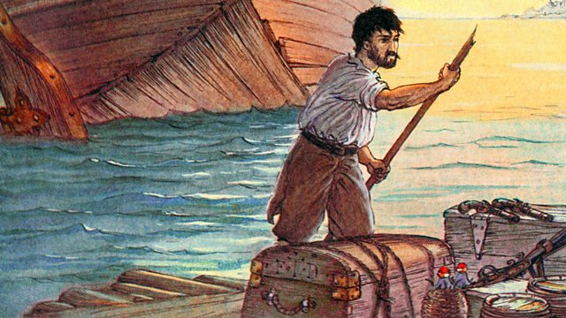
The Age of Reason The Enlightenment 1660-1800

Slide 4
The Age of Reason/Enlightenment 1660-1800
History
The 18th century offered a wealth of knowledge, exploration and rapidly growing technology. Britain had become a rich nation thanks to its trade. During this Age of Reason people strongly believed in the power of critical thinking. Religious and political leaders began losing their influence on society. Logic and progress in science were seen as the answers to all life’s great questions of freedom, democracy and fundamental rights.

Slide 5
The Age of Reason/Enlightenment 1660-1800
Literary characteristics
Rise of the novel (mostly morally uplifting and instructive novels promoting virtue, good sense, and universal benevolence, and introducing heroes who were no longer princes but representatives of the middle class.)
Value of human happiness; knowledge based on reason and evidence of the senses; ideals such as natural laws, progress, liberty,constituional government, separation of church and state.
Individual liberty and religious tolerance
“cogito, ergo sum”
Literature as a way to educate and inform the public
Satire
Literary work
Jonathan Swift’s Gulliver’s Travels, first English novel, published in 1719
Daniel Defoe’s Robinson Crusoe

Slide 7
The Age of Reason The Enlightenment 1660-1800
Daniel Defoe’s Robinson Crusoe
Now answer the questions on Robinson Crusoe in your reader.

